Slide 1

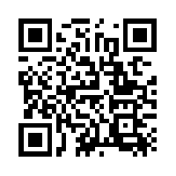
Quantum Communications Group
Key provisioning interface
Group Coordinator:
Armando Nolasco Pinto
anp@ua.pt
Group Websites:
Diogo Matos
https://www.it.pt/Groups/Index/72
LinkedIn: https://www.linkedin.com/company/quantum-communications-group-it-av/

Slide 2
OPEN
1 2
APP → KMS : Src, Dst, QoS | APP → KMS : Src, Dst, QoS, KSID
APP ← KMS : KSID, QoS | APP ← KMS : ACK, QoS
KMS sends to the SDNC a NEW_APP(Src, Dst, QoS) request on type 1, on type 2 only sends after a KSID verification. Receives the KSID.
Thought we will not use them all for now, the QoS field can have the structure defined by ETSI. For now we’ll use:
Key_chunck_size - length of the key buffer, in Bytes, requested by the app.
Key_type - 0: classical symmetric, 1: quantum symmetric, 2: oblivious.

Slide 3
GET_KEY
APP → KMS : KSID
APP ← KMS : KEY buffer
KMS relays the request (GET_KEY_ID(KSID)) to the SDNC. It returns a KID of a new or already created key.
A key buffer has the following structure:
{ “key_material”: ……… ,
“metadata”: [ metadate_size (number of chars),
{ “KID”: …, “size”: … (bytes), “type”: …, “expires_at”: timestamp} ]

Slide 4
CLOSE
APP → KMS : KSID
APP ← KMS : ACK
KMS sends a CLOSE_KSID(KSID) request to the SDNC.
The other KMS (peer) can still ask for keys if not all of them already have been retrieved.

Slide 5
Status code
0 → Successful
1 → Successful connection, but peer not connected (just a warning)
2 → GET_KEY failed because insufficient key available
3 → GET_KEY failed because peer application is not yet connected
4 → No QKD connection available
5 → OPEN failed because the KSID is invalid
6 → TIMEOUT
7 → OPEN failed, requested QoS cannot be met, counter proposal included
8 → OPEN failed, key type not supported yet
…

Slide 6
SDNC - CONNECT
KMS → QKDC : KMSID
KMS ← QKDC : ACK
At this moment this request will not do much, but will be essential in the future when more control over the network will be implemented.

Slide 7
SDNC - NEW_APP
1 2
KMS → QKDC : Src, Dst, QoS | QKDC : Src, Dst, QoS, KSID
KMS ← QKDC : KSID, QoS | KMS ← QKDC : ACK, QoS
On type 1, generates a KSID, returns it and uses it as key to a structure where the information about the key stream is stored - QoS, connected KMSs, associated KIDs, etc.
On type 2, checks the KSID that shall already exist and updates key stream state.
The QoS is verified, if cannot be met, a counter proposal is returned.

Slide 8
SDNC - GET_KEY_ID
KMS → QKDC : KSID
KMS ← QKDC : KID
Checks if a key was already request by the peer if…
yes, returns the respective KID. If more than one key is available, returns the oldest.
no, generates a valid KID and returns it. Notifies the other KMS in order to create the key on its side. The key relay would be triggered at this moment.

Slide 9
SDNC - CLOSE_KS
KMS → QKDC : KSID
KMS ← QKDC : ACK
Updates key stream state. The KSID it’s still active until the other KMS sends an identical request.

Slide 10
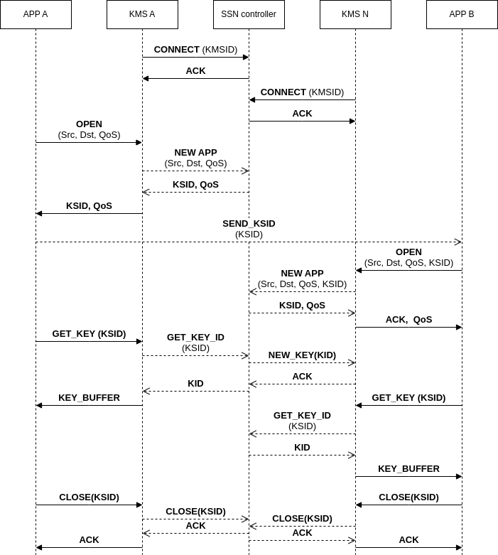
NO ERROR - SEQUENCE DIAGRAM

Slide 11
Best practices
Each message should have a header with the id of the sender and other useful info.
Specially communications between KMSs and the QKDC on some requests, like a OPEN request, require an acknowledgment from the client. This way the QKDC don’t save unnecessary information.
Both KSIDs and KIDs should by random and unique UIDs (maybe use timestamp to ensure uniqueness).

